Slide 1

CS 53D Intro To Computer Forensics
Tim Ryan
ryantimothy@fhda.edu

Slide 2
CS53D: Intro to Computer Forensics
Week 4 Agenda
Course and Assignment Review
Browser and Email Forensics
Elective and Extra-Credit Labs
Cloud Forensics
Mobile Device Forensics
Cellular Service Forensics
Lab #16: Intro to Android OS
Lab #17: Android Acquisition

Slide 3
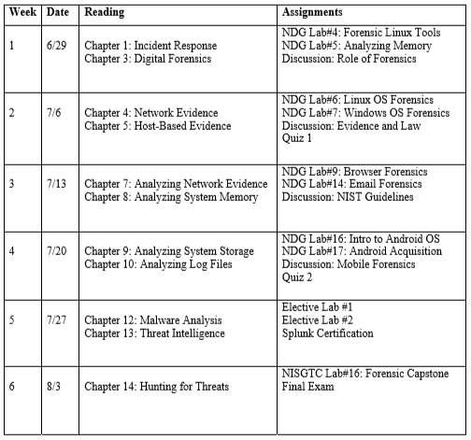
Course Outline - Subject to Minor Changes

Slide 4
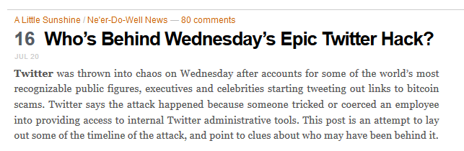
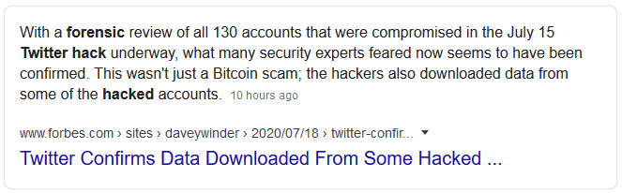

Slide 5
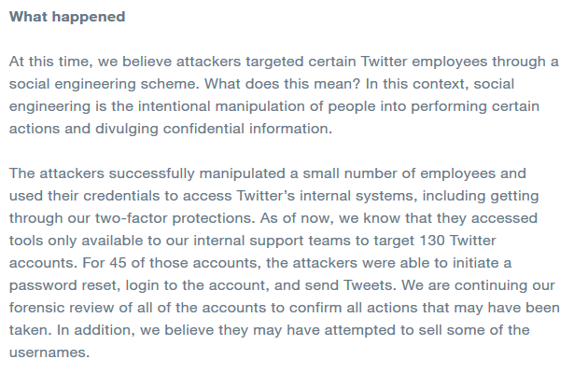
Twitter Blog, July 17 8:35PM
Source: https://blog.twitter.com/en_us/topics/company/2020/an-update-on-our-security-incident.html

Slide 6
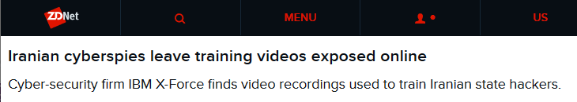
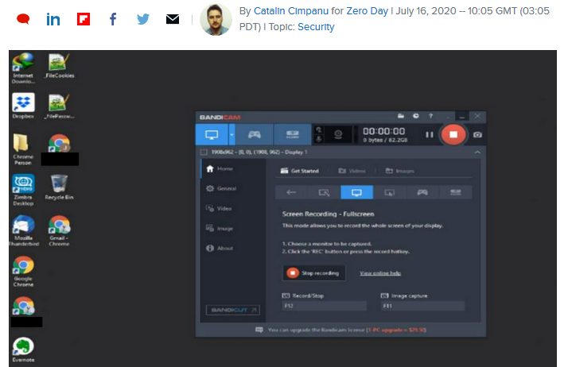
Source: https://www.zdnet.com/article/iranian-cyberspies-leave-training-videos-exposed-online/

Slide 7
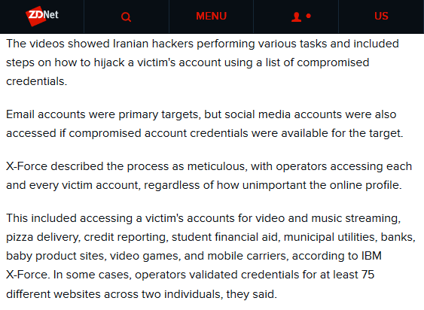

Slide 8
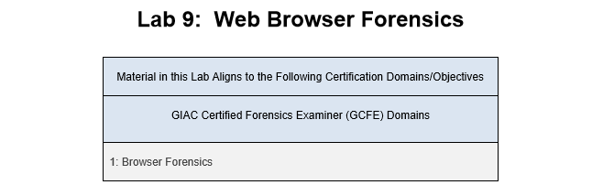
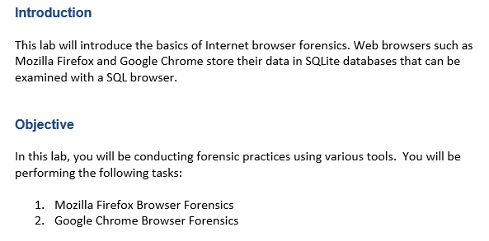
Week 3 Lab Assignment

Slide 9
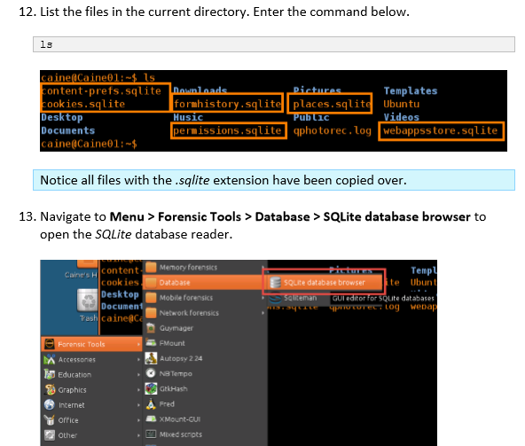

Slide 10
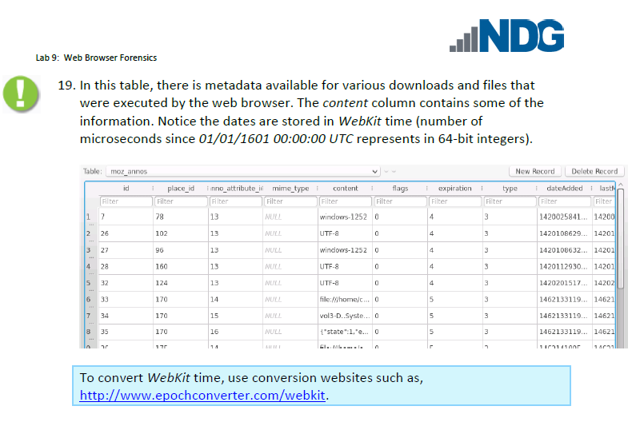
Browser Forensics - Mozilla

Slide 11
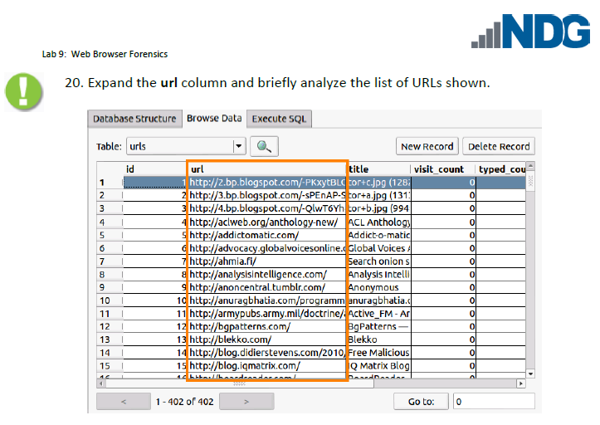
Browser Forensics - Chrome

Slide 12
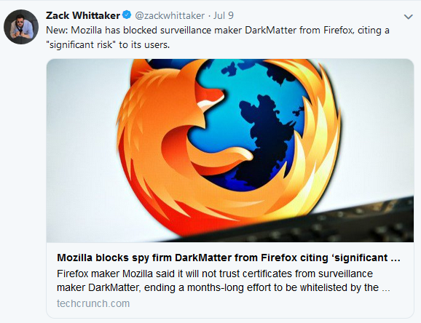
Surveillance = Forensics = Evidence

Slide 13
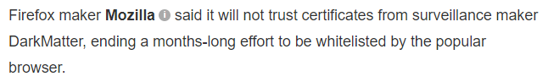
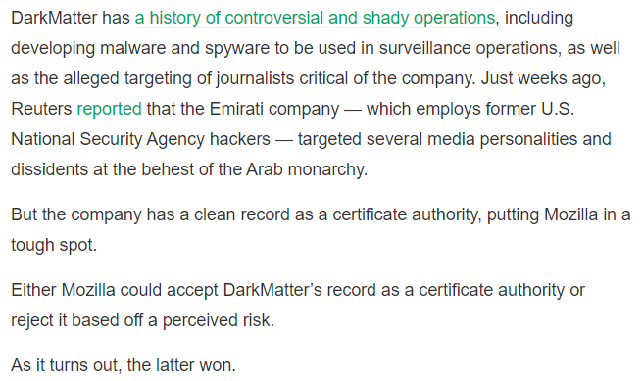
Source: https://techcrunch.com/2019/07/09/darkmatter-firefox-certificates/

Slide 14
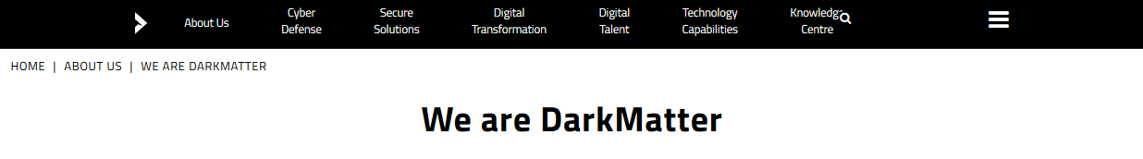
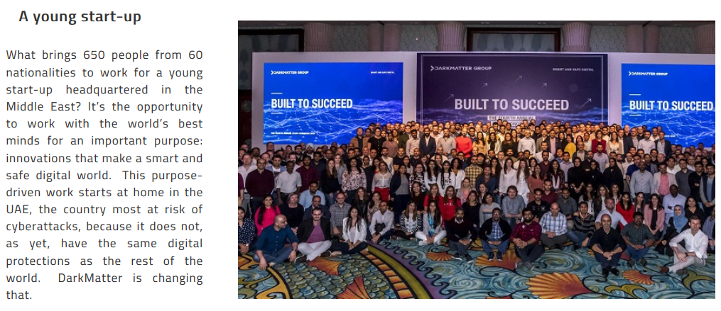
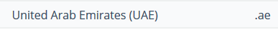
Source: https://www.darkmatter.ae/about-us/we-are-darkmatter/

Slide 15
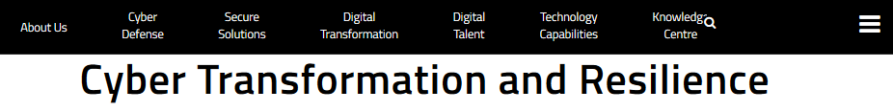
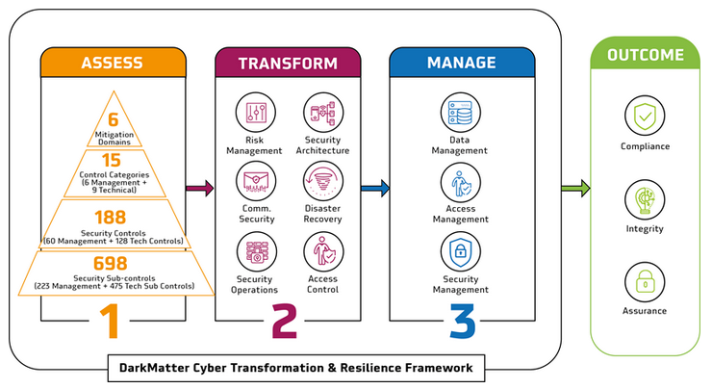

Slide 16
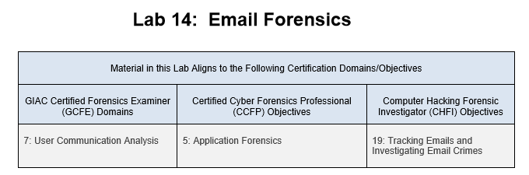
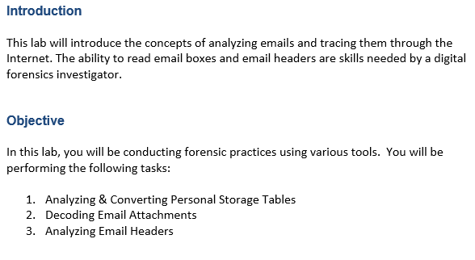
Week 3 Lab Assignment

Slide 17
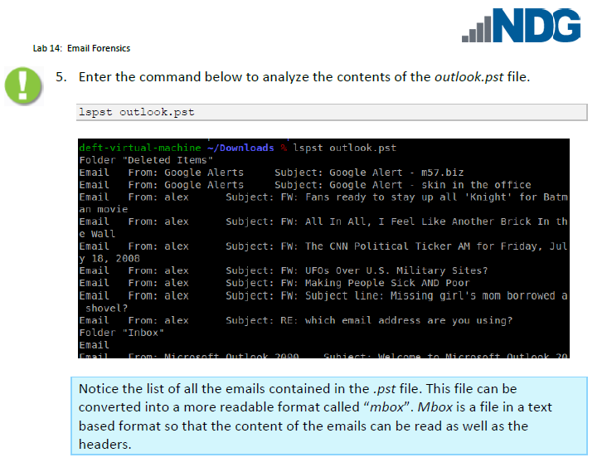
Email Forensics - Outlook

Slide 18
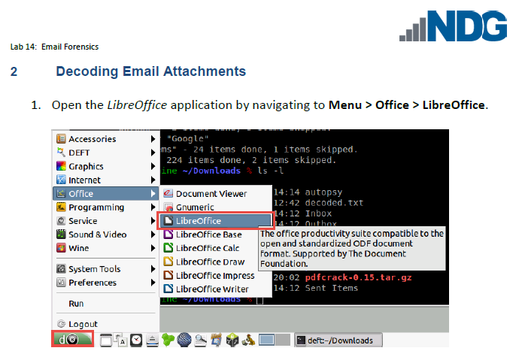
Email Forensics - LibreOffice

Slide 19
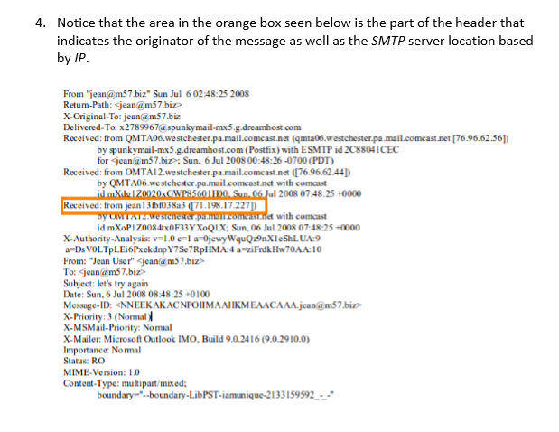
Email Header Information

Slide 20
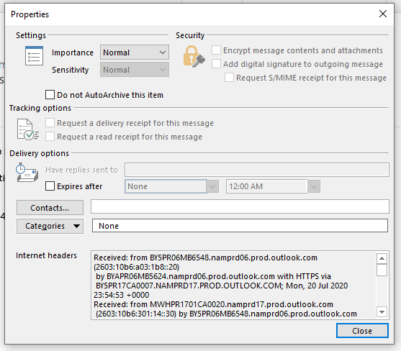
Outlook Message Properties

Slide 21
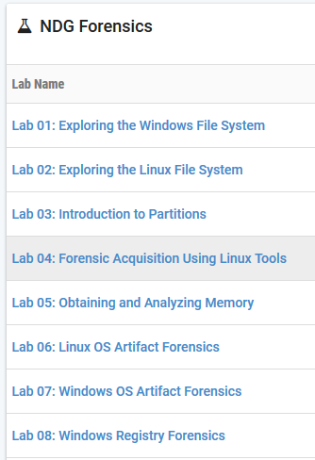
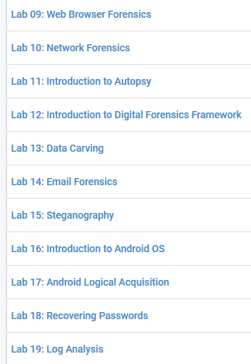
Elective and Extra-Credit Lab Options

Slide 22
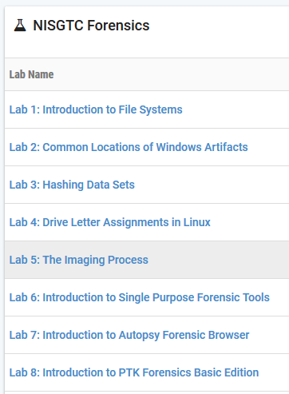
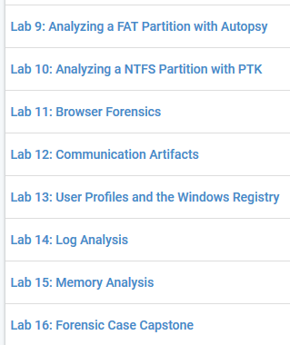
Elective and Extra-Credit Lab Options

Slide 23
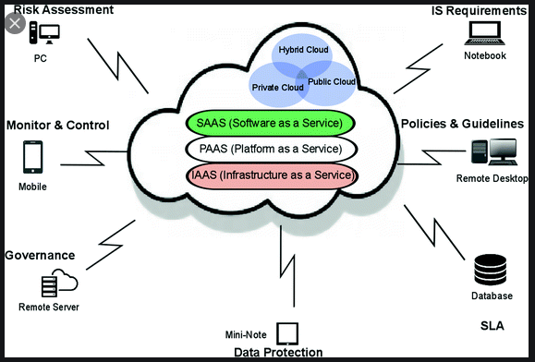
Cloud Services Are Everywhere

Slide 24
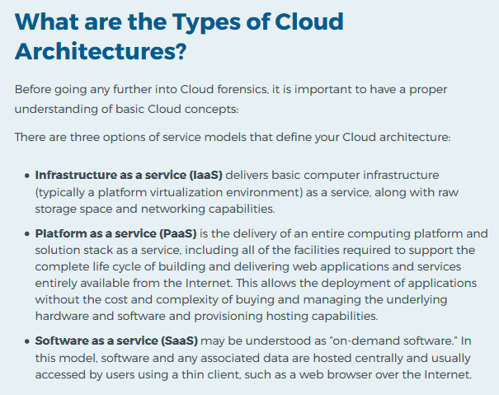
Source: https://resources.infosecinstitute.com/category/computerforensics/introduction/
areas-of-study/hybrid-and-emerging-technologies/introduction-to-cloud-forensics/#gref

Slide 25
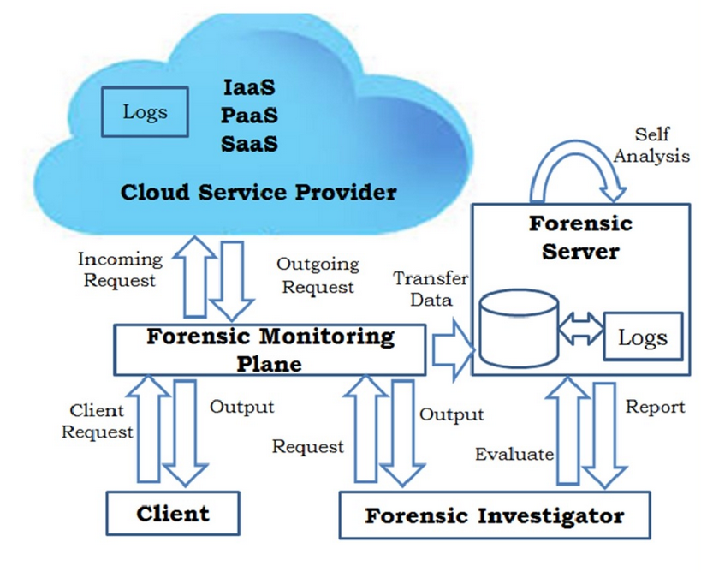
Cloud Forensics Architecture (Logs -> Splunk)

Slide 26
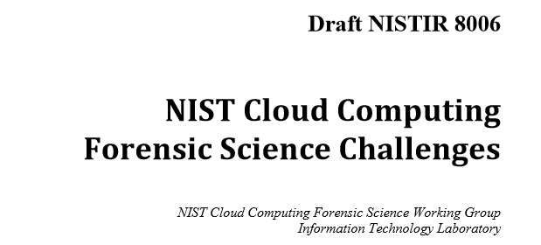

Source: https://csrc.nist.gov/CSRC/media/Publications/nistir/8006/draft/documents/draft_nistir_8006.pdf

Slide 27
NIST Cloud Computing Forensic Science Challenges
3.1 Collection and Aggregation Challenges
Establish a Common Vocabulary
Create an On-Going Dialogue
3.2 Data Analysis
Resource Pooling, Rapid Elasticity, Measured Service
Architecture, Data Collection, Incident First Responders
Role Management, Legal, Standards, Training
Anti-Forensics (Obfuscation, Data Hiding, Malware)
4.1 Additional Observations
Time, Location, Sensitive Data

Slide 28
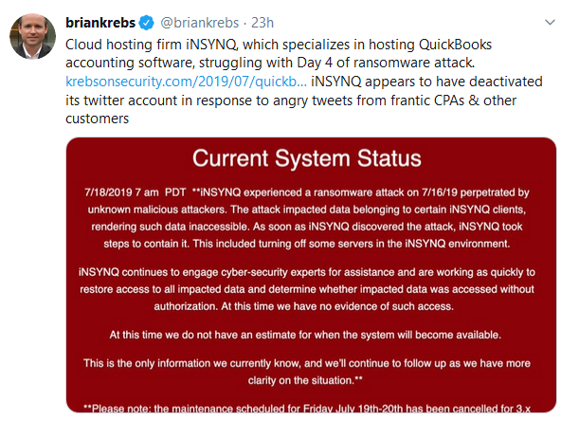
Cloud Ransomware Example: iNSYNC

Slide 29
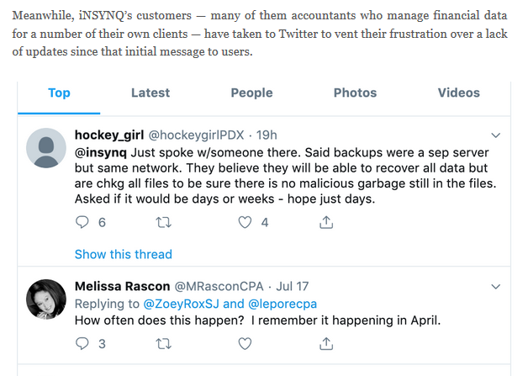
Twitter Responses – Forensic Archive

Slide 30
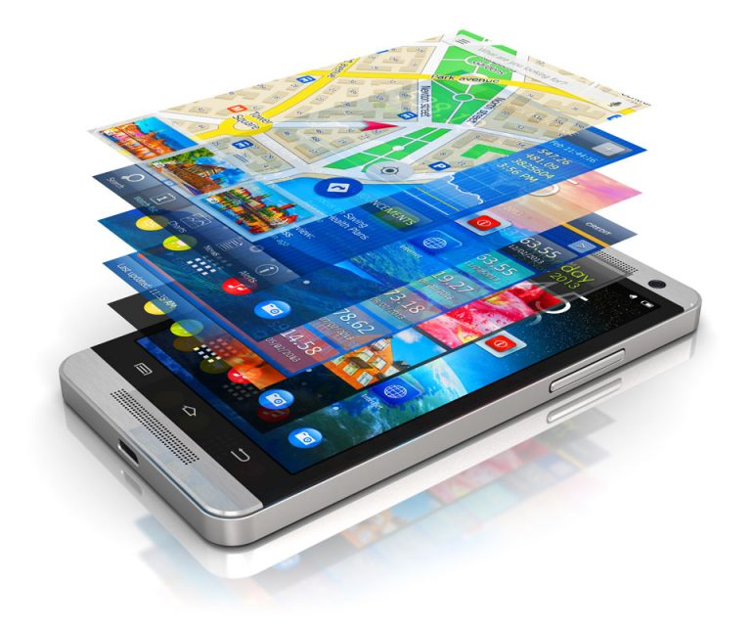
Mobile Device Forensics

Slide 31
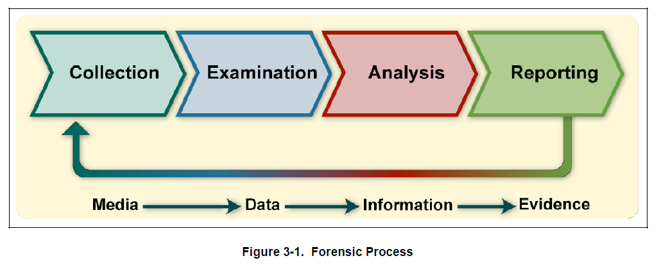
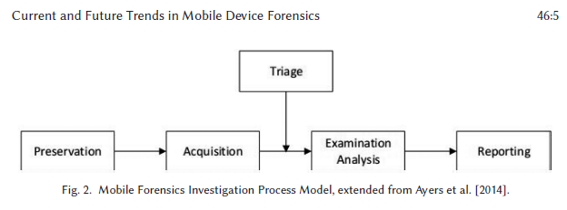
Non-Mobile Forensics Process
Mobile Forensics Process

Slide 32
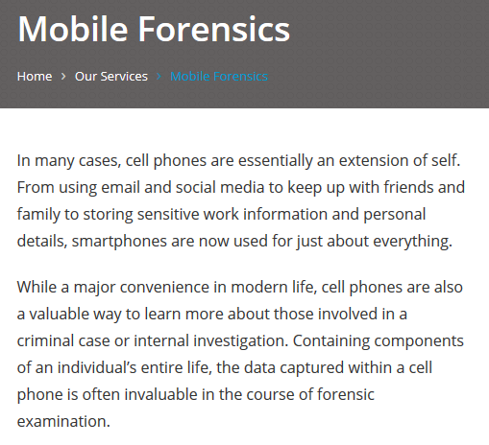
Source: https://computerforensicsresources.com/service/mobile-forensics/

Slide 33
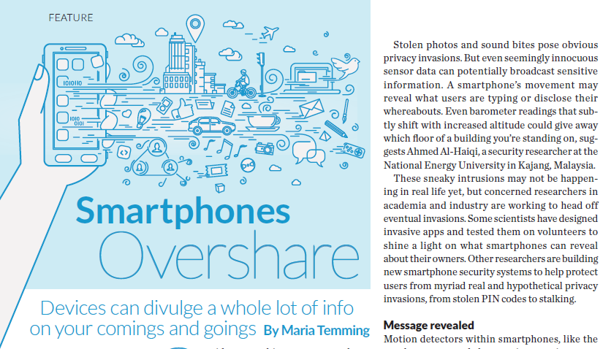
Overshare = Too Much Information

Slide 34
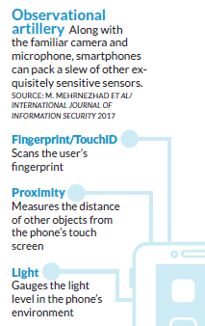
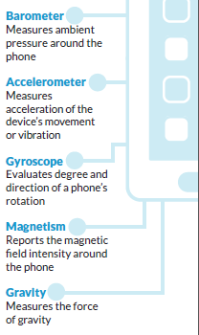
Overshare Examples – Others?

Slide 35
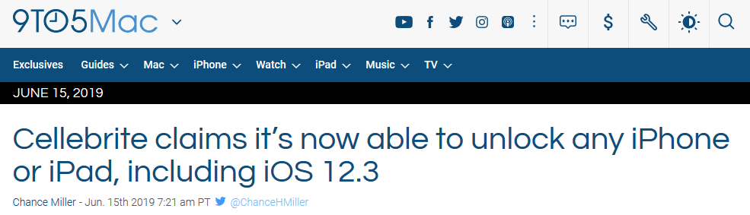
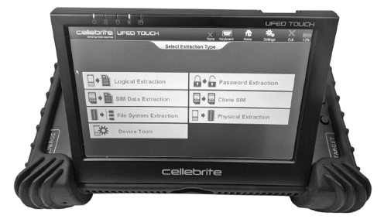

Slide 36
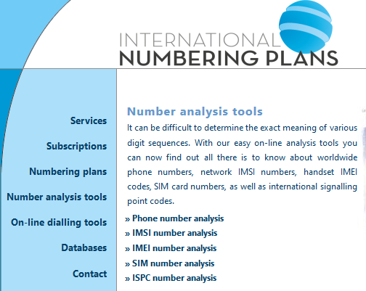
Source: https://numberingplans.com/?page=analysis

Slide 37
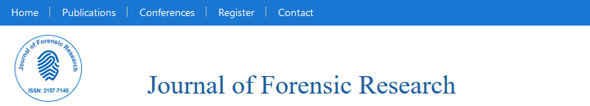
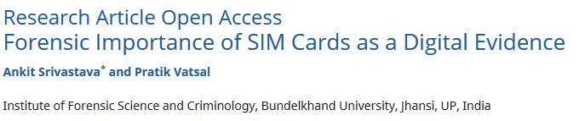
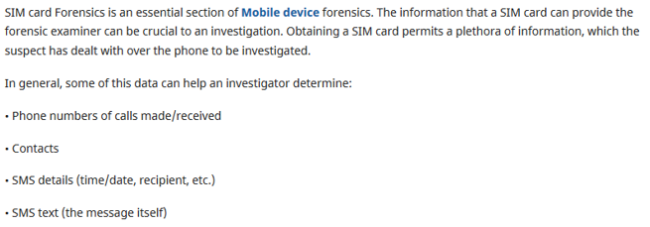

Slide 38
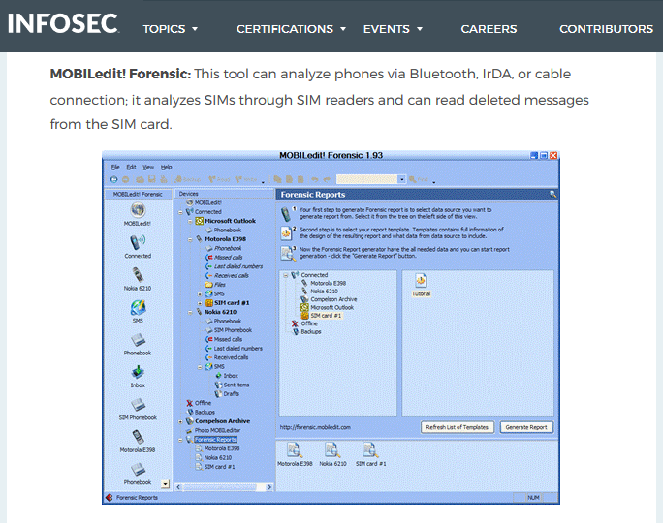
Source: https://resources.infosecinstitute.com/sim-card-forensics-introduction/#gref

Slide 39

Mobile Device vs Cellular Systems
Very Different Forensic Environment

Slide 40


Slide 41

Cellular Evidence Example - Metadata

Slide 42

www.antennasearch.com

Slide 43

Los Altos Tower Results

Slide 44

Canvas/Files/Forensics Documents

Slide 45


Slide 46

Source: https://www.zdnet.com/article/what-is-5g-everything-you-need-to-know/

Slide 47


Slide 48

Week 4 Discussion Question

Slide 49

Canvas/Files/Forensics Documents
“Week 4 Mobile Users” (15 Pages)

Slide 50

Week 4 Reading Assignment

Slide 51

Week 4 Reading Assignment

Slide 52

Week 4, Quiz 2
10 Questions, 30 Minutes

Slide 53


Slide 54


Slide 55


